Slide 1
DATA QUALITY AND DATA VALIDATION
DATA COLLECTION AND DATA PROCESSING
Martin: Data is messy.
Allison: Even when it’s been cleaned?
Martin: Especially when it’s been cleaned.
P. Boily, The Great Balancing Act

Slide 2
Learning Objectives
Understand common sources of data error and types of potential issues
Understand difference between accuracy and precision
Understand, at a high level, some techniques for detecting data issues
Familiarity with some examples of data validity issues

Slide 3
Sound Data
The ideal dataset will have as few issues as possible with:
Validity: data type, range, mandatory response, uniqueness, value, regular expressions
Completeness: missing observations
Accuracy and Precision: related to measurement and/or data entry errors; target diagrams (accuracy as bias, precision as standard error)
Consistency: conflicting observations
Uniformity: are units used uniformly throughout?
Checking for data quality issues at an early stage can save headaches later in the analysis.

Slide 4

Sound Data
accurate and precise
precise but not accurate
accurate but not precise
neither accurate nor very precise

Slide 5
Common Sources of Error
When dealing with legacy, inherited or combined datasets (that is, datasets over which you have little control):
Missing data given a code
‘NA’/‘blank’ given a code
Data entry error
Coding error
Measurement error
Duplicate entries
Heaping

Slide 6
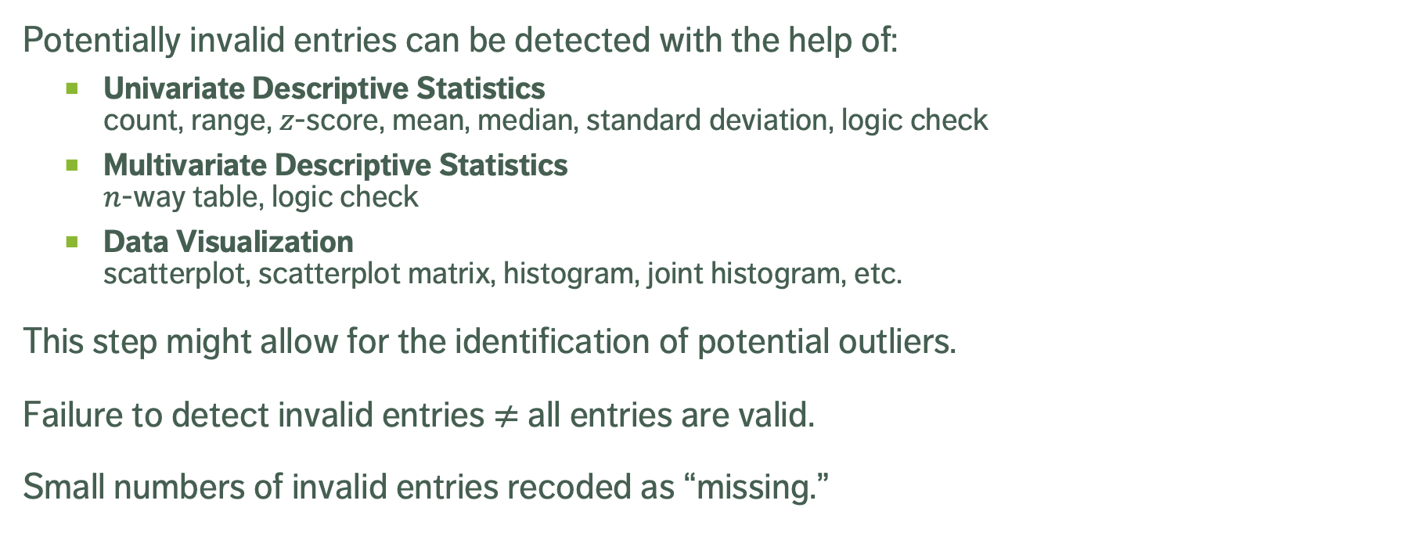
Detecting Invalid Entries
Potentially invalid entries can be detected with the help of:
Univariate Descriptive Statistics count, range, $z$-score, mean, median, standard deviation, logic check
Multivariate Descriptive Statistics $n$-way table, logic check
Data Visualization scatterplot, scatterplot matrix, histogram, joint histogram, etc.
This step might allow for the identification of potential outliers.
Failure to detect invalid entries $≠$ all entries are valid.
Small numbers of invalid entries recoded as “missing.”
Notes:
Email story? Smart phone story?

Slide 7
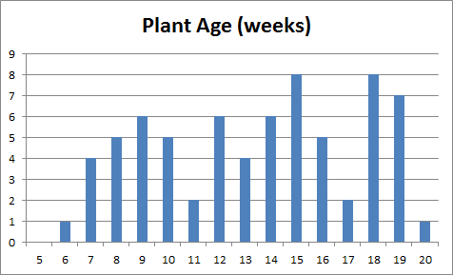
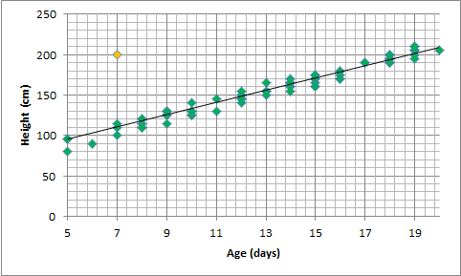
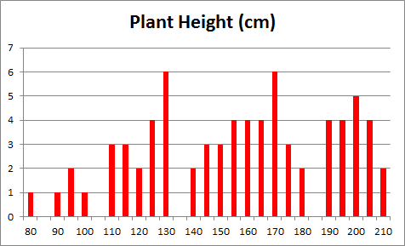
Plant Growth Dataset
[Personal file]

Slide 8
Arrivals Dataset
[Personal file]
Time of arrivals at screening station, prior to departure (mins)

Slide 9
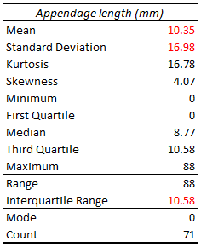
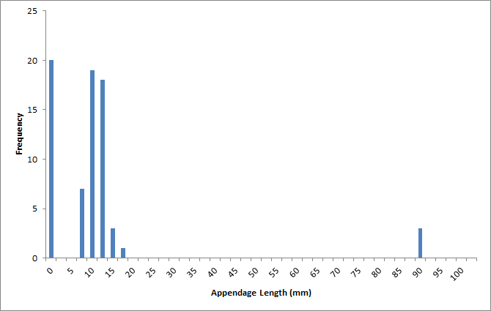
Appendages Dataset
[Personal file]

Slide 10
TAKE-AWAYS
Don't wait until after the analysis to find out there was a problem with data quality.
Univariate tests don’t always tell the whole story.
Visualizations can help.
Context is crucial – you may need more context about the data in order to make sense of what you see… but whatever the situation, you need to understand the dataset quality.

